Slide 1

18CSC303J -Database Management Systems
UNIT-II

Slide 2
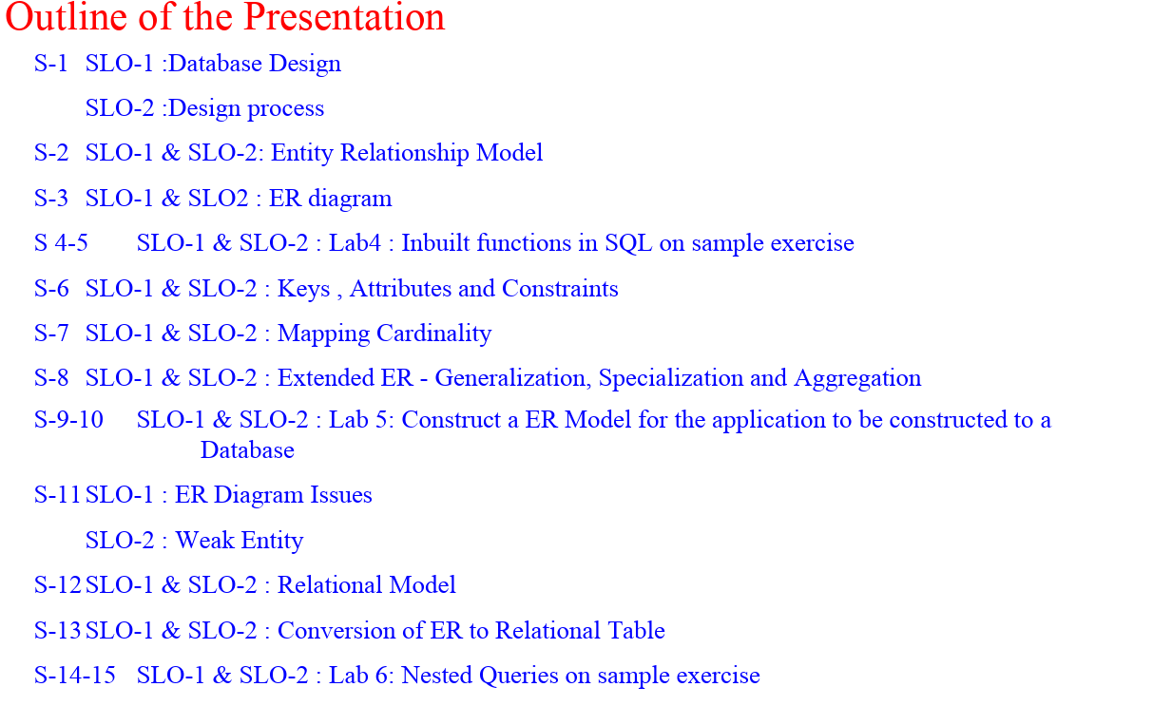

Slide 3
S-1 SLO-1 : Database Design
Database systems are developed to manage large amount of specific domain and related domain.
Database design involves, designing database schema.
The complete design of the database of application environment based on the requirements given by the environment/business
The database design to be thoroughly discussed and designed by both database designer / developer and authorities from the enterprise (domain).

Slide 4
S-1 SLO-2 :Design process
Design Process
Conceptual design
✔A high level data model provides the database designer with a conceptual frame work which includes
What kind of data required by the database users?
How the database to be designed to fulfill the requirements?
✔Database designer should choose the appropriate data model and translate these requirements into a conceptual schema.
✔The schema developed at this conceptual-design phase provides a detailed overview of the enterprise.
✔The designer, review the schema to confirm that all data requirements.
✔The designer can review the design to remove the redundant features
✔The focus at this point is on describing the data and their relationships, rather than on specifying physical storage details.

Slide 5
S-1 SLO-2 :Design process
Design Process
Specification of functional requirements
The fully developed conceptual schema provides the functional requirements of the enterprise.
Functional requirements describe about what kind of operation / transaction to be performed on the data.
The operations are:
•Updating or Modifying data • Retrieval of data for processing • Deleting the data
Designer can review the schema to ensure it meets all the functional requirements.

Slide 6
S-1 SLO-2 :Design process
Design Process
✔The process of moving from an abstract data model to the implementation of the database proceeds in two final design phases.
Logical Design Phase
✔The designer maps the high level conceptual schema onto the data model
Physical Design Phase
✔The physical features of database are specified
• File organization
• Internal storage structures

Slide 7
S-1 SLO-2 :Design process
Database Design for a University
✔The initial specifications of the user requirements may collected
• Discussion with database users
• Designer’s own analysis
✔It helps to design the conceptual structure of database

Slide 8
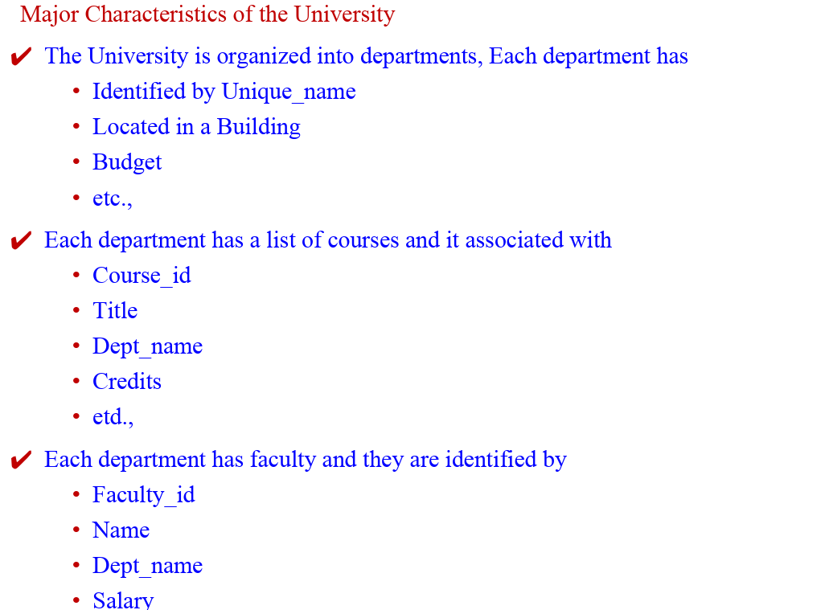
S-1 SLO-2 :Design process

Slide 9
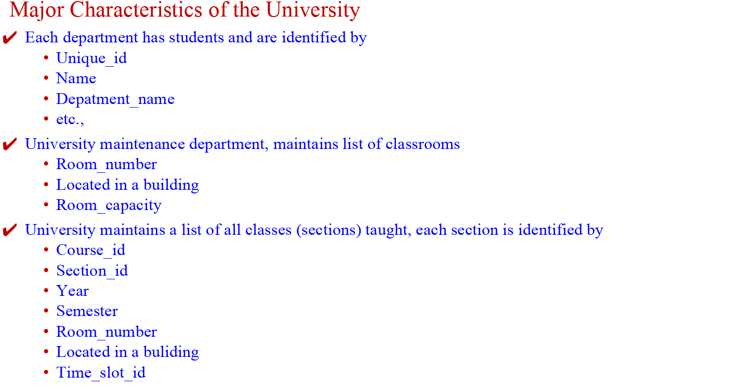
S-1 SLO-2 :Design process

Slide 10
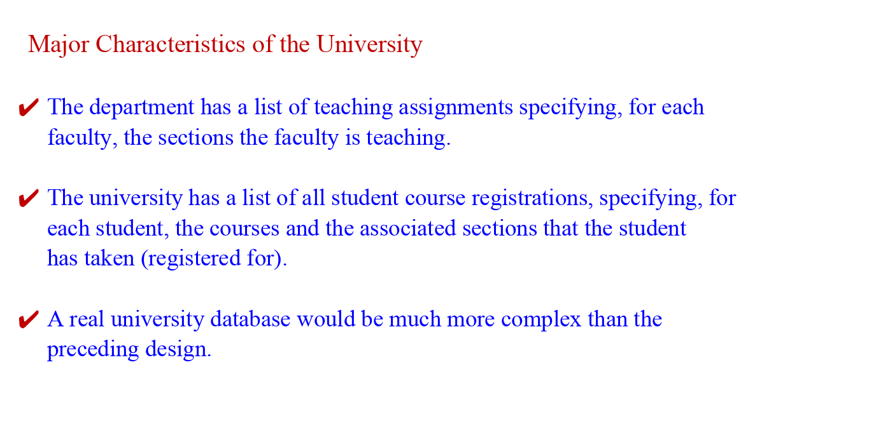
S-1 SLO-2 :Design process

Slide 11
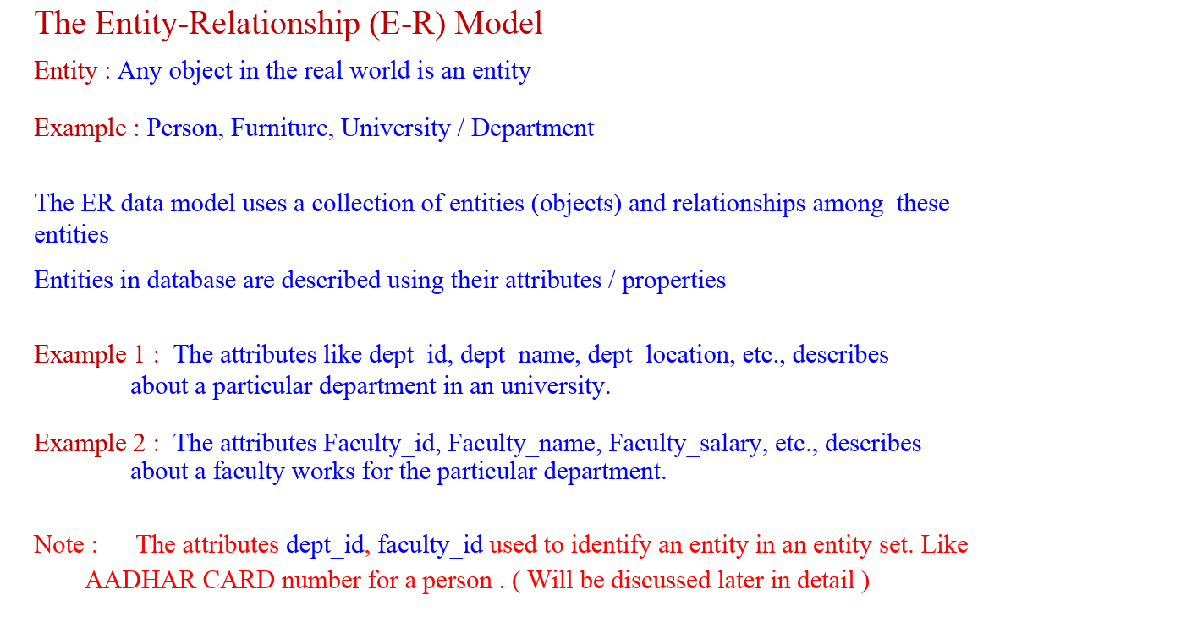
S-1 SLO-2 :Design process

Slide 12
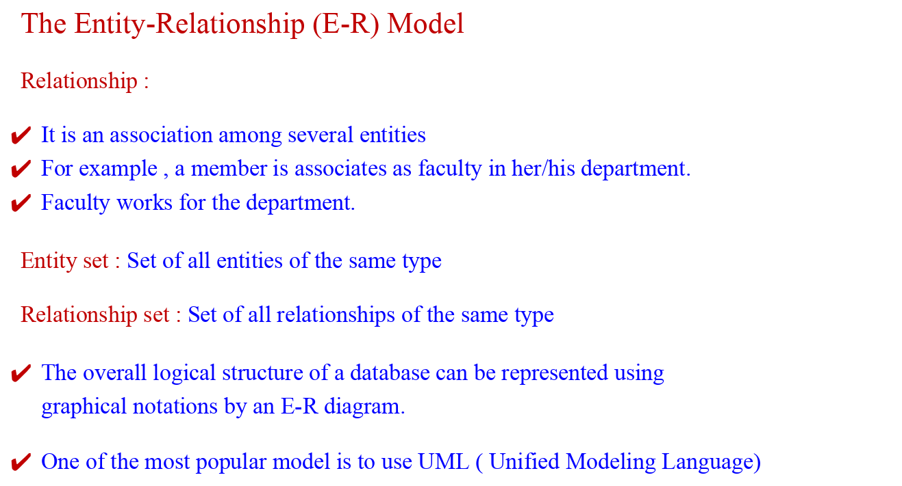
S-1 SLO-2 :Design process

Slide 13
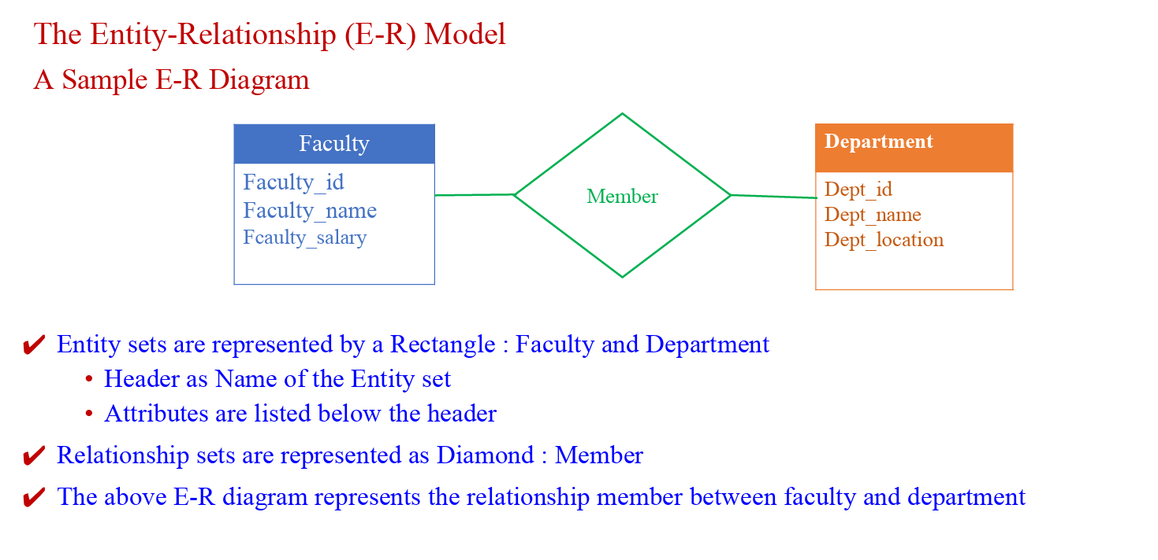
S-1 SLO-2 :Design process

Slide 14
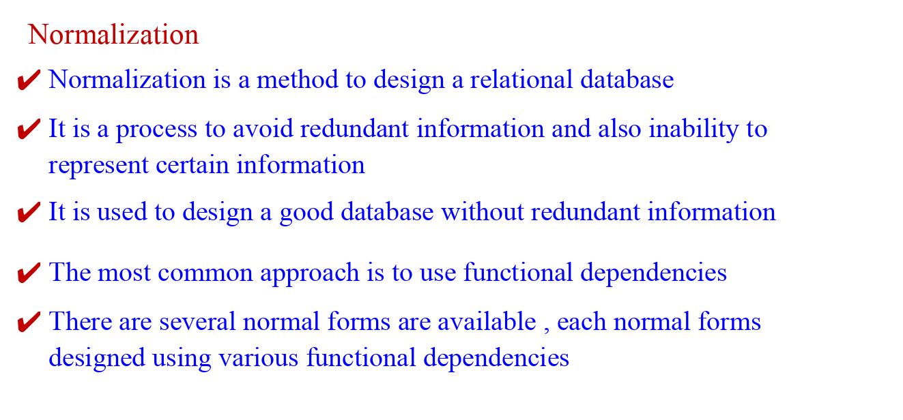
S-1 SLO-2 :Design process

Slide 15
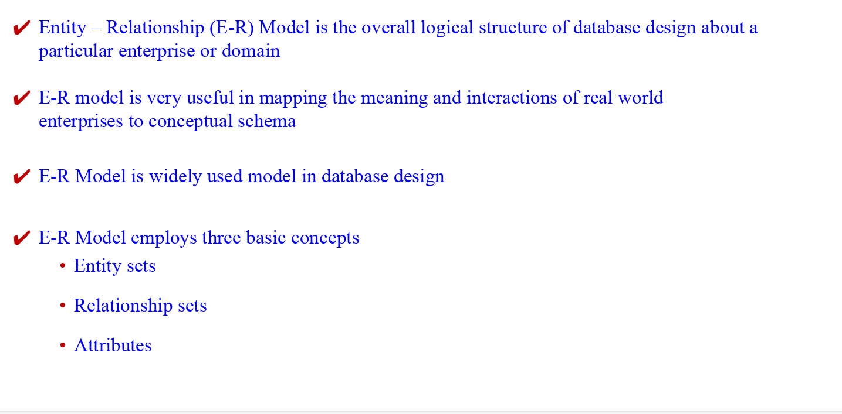
S-2 SLO-2 & SLO-2 :Entity Relationship Model

Slide 16
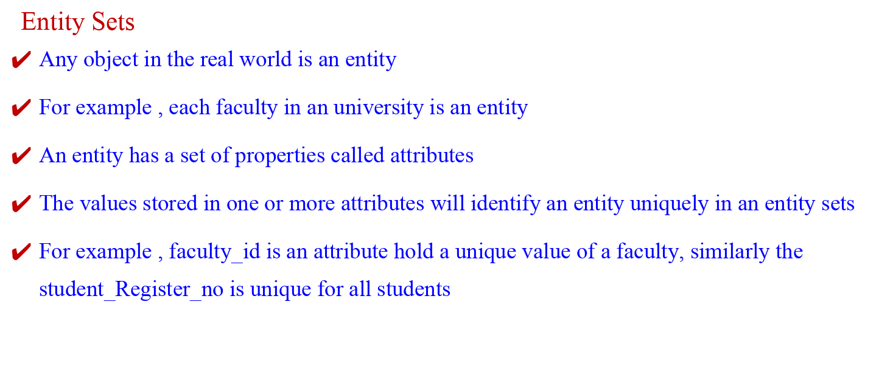
S-2 SLO-2 & SLO-2 :Entity Relationship Model

Slide 17
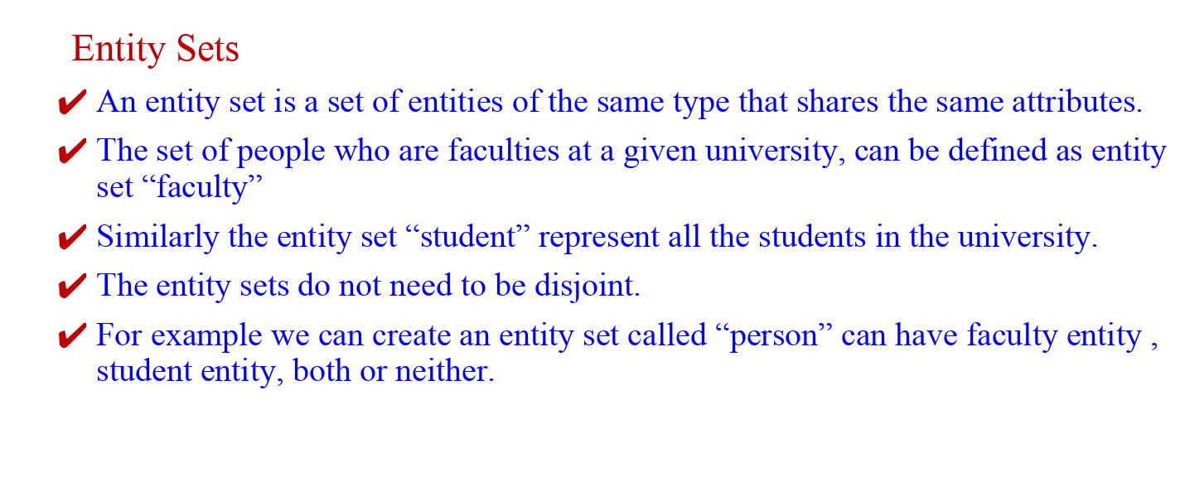
S-2 SLO-2 & SLO-2 :Entity Relationship Model

Slide 18
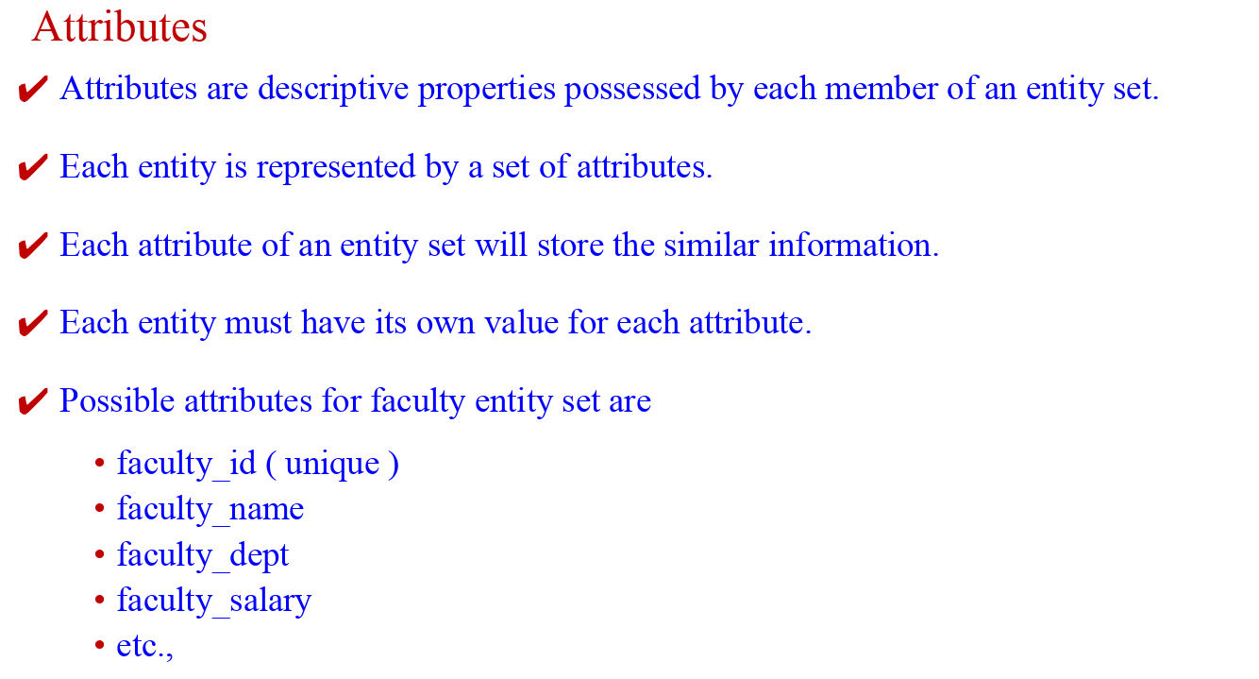
S-2 SLO-2 & SLO-2 :Entity Relationship Model

Slide 19
S-2 SLO-2 & SLO-2 :Entity Relationship Model
Values
✔ Each entity has a value for each attribute
✔ For instance , the particular faculty entity may have the following values :
• faculty_id = 123
• faculty_name= ‘Bill’
• faculty_ dept= = ‘IT’
• faculty_salary = = 123456
• faculty_mobile = 9999955555
✔ The faculty_id attribute is used to identity the faculty uniquely , because there is a possibility for more number of faculties will have the same name
✔ In general the university use to assign unique id for faculty and students (Reg. No)

Slide 20
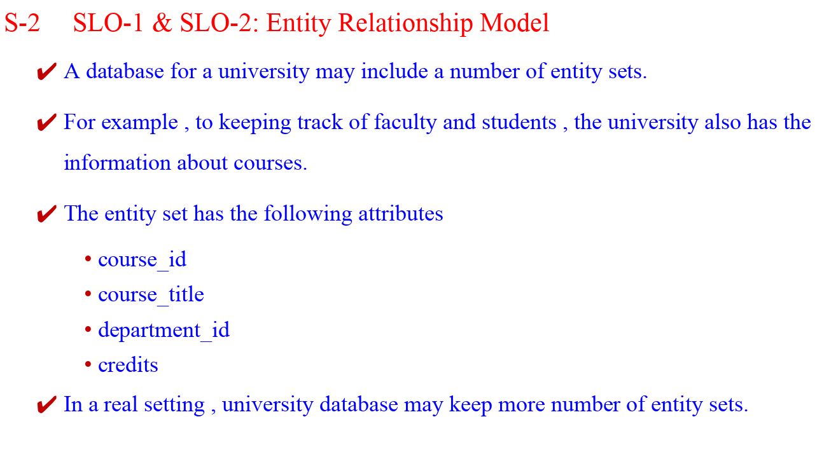

Slide 21
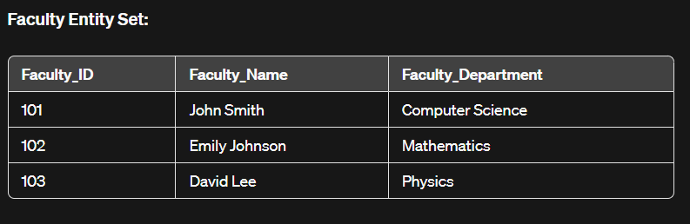
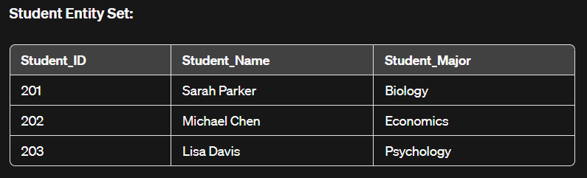
S-2 SLO-2 & SLO-2 :Entity Relationship Model
Entity sets faculty and student
Entity set : Faculty
Entity set : Student

Slide 22
S-2 SLO-2 & SLO-2 :Entity Relationship Model
Relationship Sets
A relationship is an association among several entities.
For example, we can define a relationship "counselor" that associates faculty "John Smith" with the student "Sarah Parker".
The relationship specifies that "John Smith" is a counselor to student "Sarah Parker".
A relationship set is a set of relationships of the same type.
Formally, it is a mathematical relation on n ≥ 2 (possibly non-distinct) entity sets.
If E1, E2,..., En are entity sets, then a relationship set R is a subset of
{(e1,e2,...,en) | e1 ∈ E1, e2 ∈ E2,..., en ∈ En} where (e1,e2,...,en) is a relationship.

Slide 23
S-2 SLO-2 & SLO-2 :Entity Relationship Model
Relationship Sets
In this case, the relationship set "counselor" would be represented as:
Counselor = {(John Smith, Sarah Parker)}
This indicates that "John Smith" is a counselor to "Sarah Parker".

Slide 24
S-2 SLO-2 & SLO-2 :Entity Relationship Model
Consider the two entity sets Faculty and Student ( Ref : Slide No 21)
We define the relationship set counselor to denote the association between faculty and students.
The following figure represents this association

Slide 25
S-2 SLO-2 & SLO-2 :Entity Relationship Model
Relationship Sets
The association between entity sets is referred to as participation.
The entity sets E1, E2,..., En participate in relationship set R.
A relationship instance in an E-R schema represents an association between the named entities in the real-world enterprise that is being modeled.
To explain this, the individual faculty entity John Smith, who has faculty_id 101, and the student entity Sarah Parkerwho has student_regno 201 participate in a relationship instance counselor/advisor.
This relationship instance represents that in the university, the faculty "John Smith" is advising student "Sarah Parker".
Advisor = {(Faculty_ID: 101, Student_ID: 201)}
This indicates that "John Smith" with Faculty_ID 101 is advising "Sarah Parker" with Student_ID 201.

Slide 26
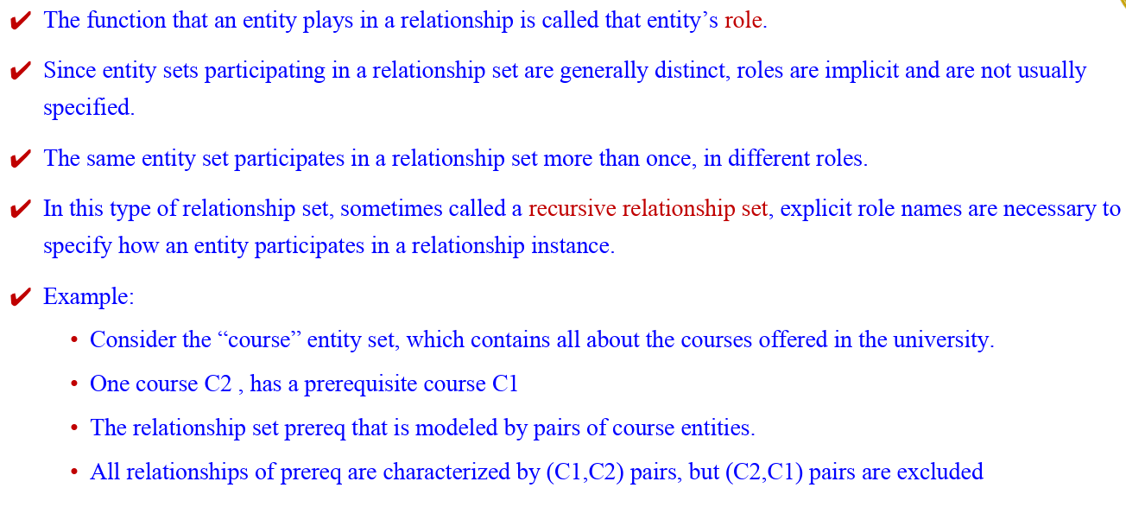
S-2 SLO-2 & SLO-2 :Entity Relationship Model

Slide 27
S-2 SLO-2 & SLO-2 :Entity Relationship Model
A relationship may also have attributes called descriptive attributes.
Consider a relationship set “advisor” with entity sets Faculty and Student.
The attribute "date" can be associated with that relationship to specify the date when the faculty became the advisor of a student.
For example, the advisor relationship among the entities corresponding to faculty "John Smith" and student "Sarah Parker" has the value “3 Jan 2022” for attribute "date", which means that "John Smith" became "Sarah Parker"’s advisor on January 3, 2022.
In this case, we can represent this as:
Advisor = {(Faculty_ID: 101, Student_ID: 201, Date: 3 Jan 2022)}
This indicates that "John Smith" with Faculty_ID 101 started advising "Sarah Parker" with Student_ID 201 on January 3, 2022.

Slide 28
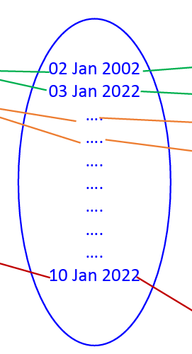
S-2 SLO-2 & SLO-2 :Entity Relationship Model
Consider a relationship set "counselor" with a descriptive attribute "date".
The figure shows that the faculty "John Smith" counsels two students with two different counseling dates.

Slide 29
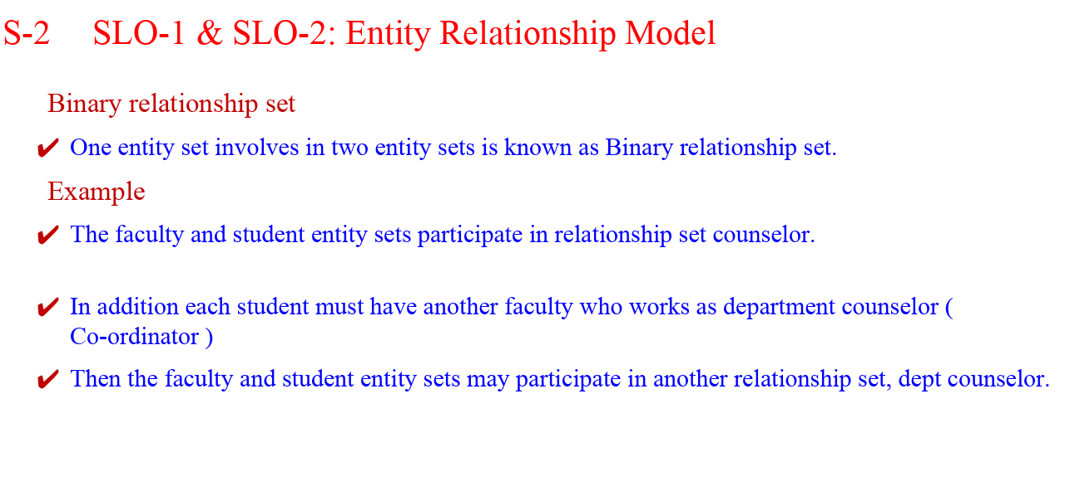

Slide 30
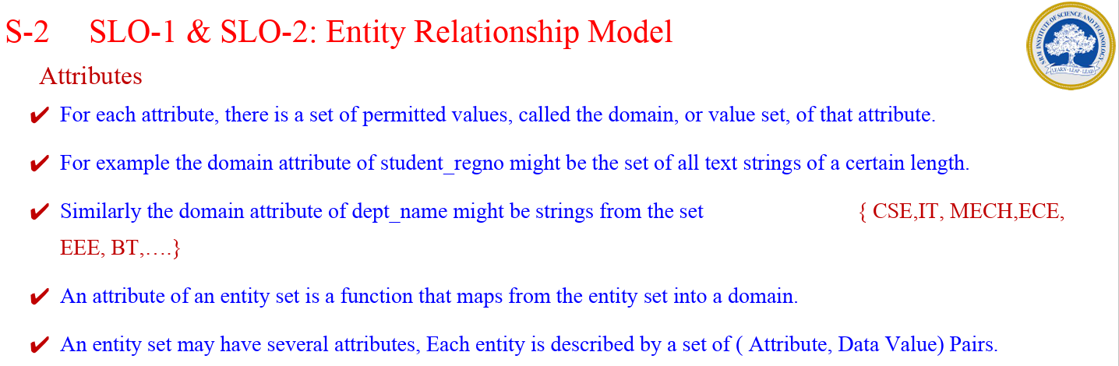
For example , A particular ,the Faculty entity may be described by a set {(Faculty_ID, 101), (Faculty_Name, John Smith), (Dept_Name, Computer Science), (Salary, $70,000)}

Slide 31
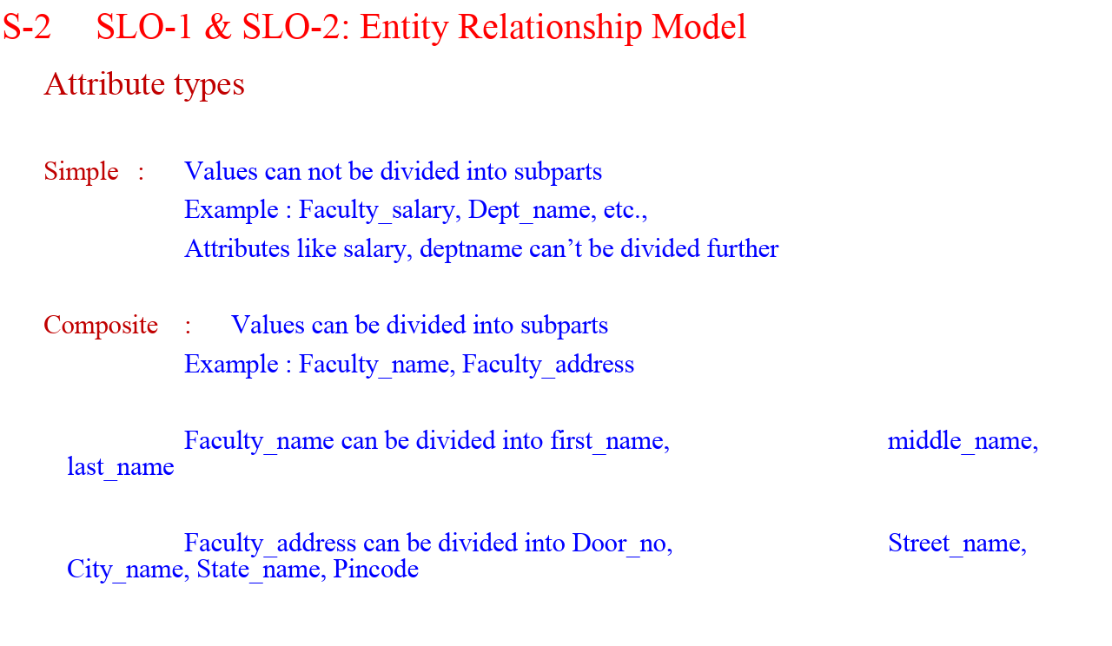

Slide 32
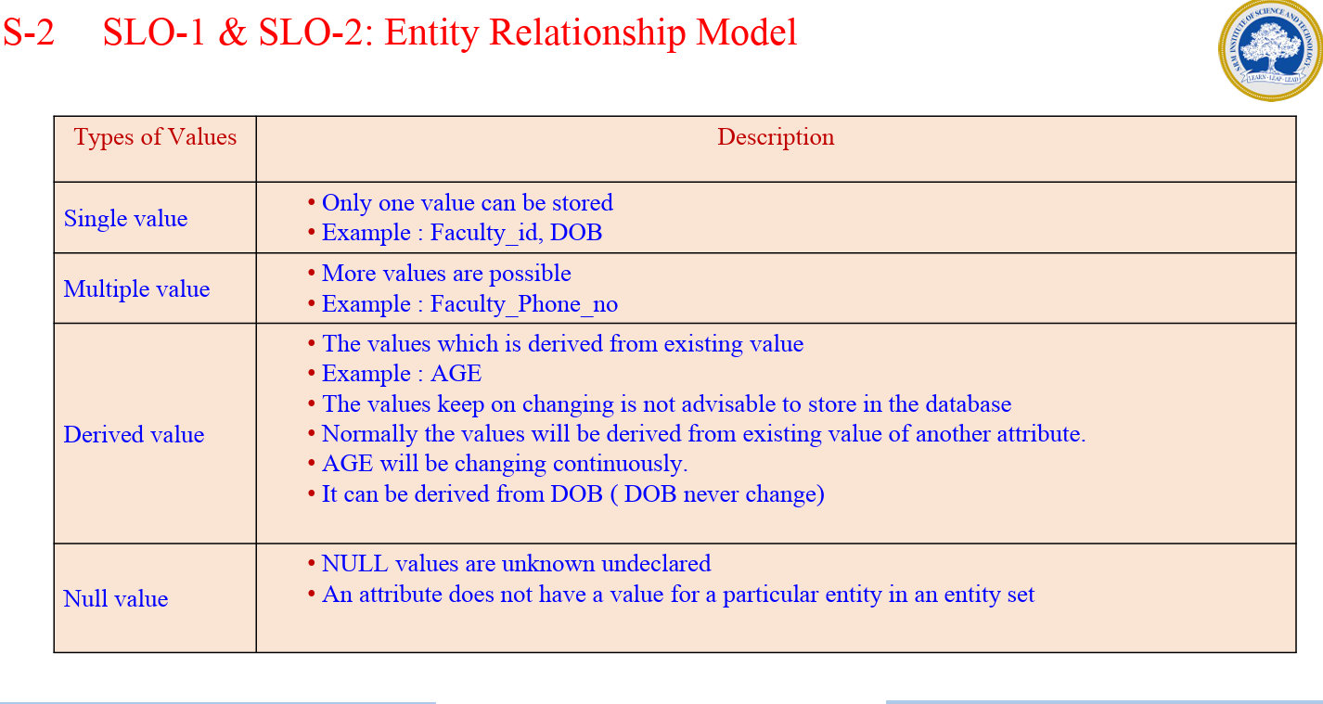

Slide 33
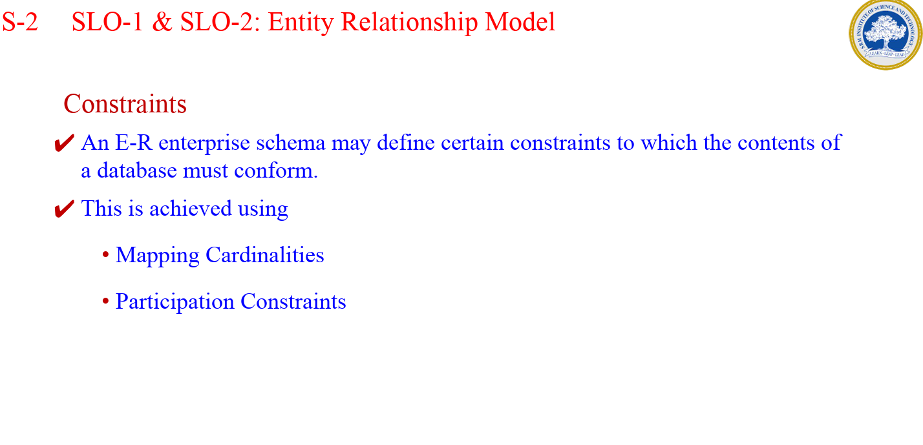

Slide 34
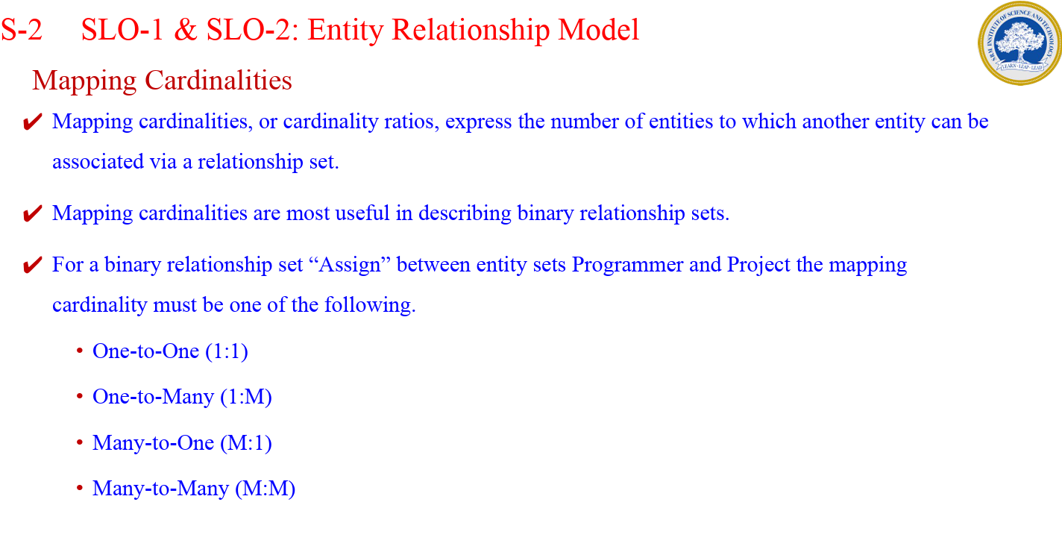

Slide 35
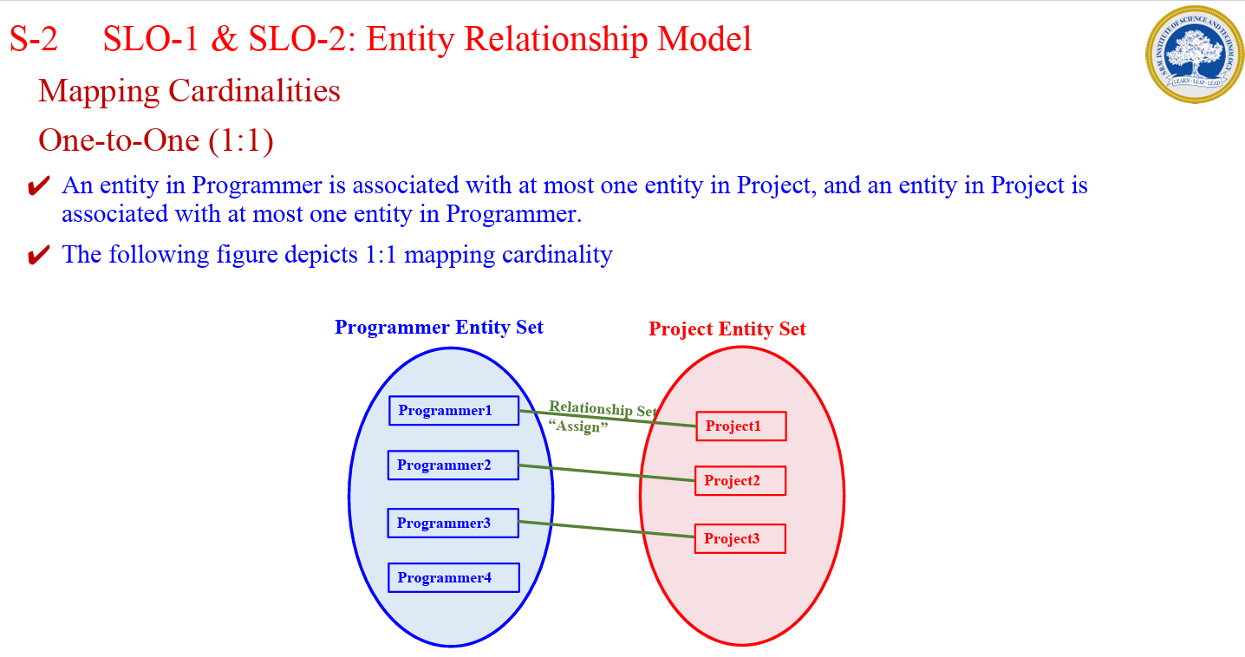

Slide 36
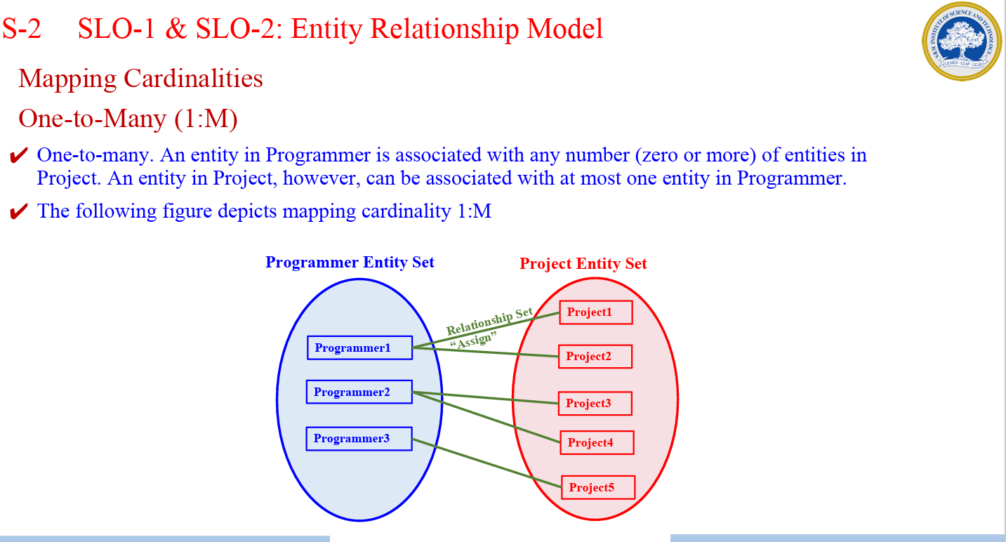

Slide 37
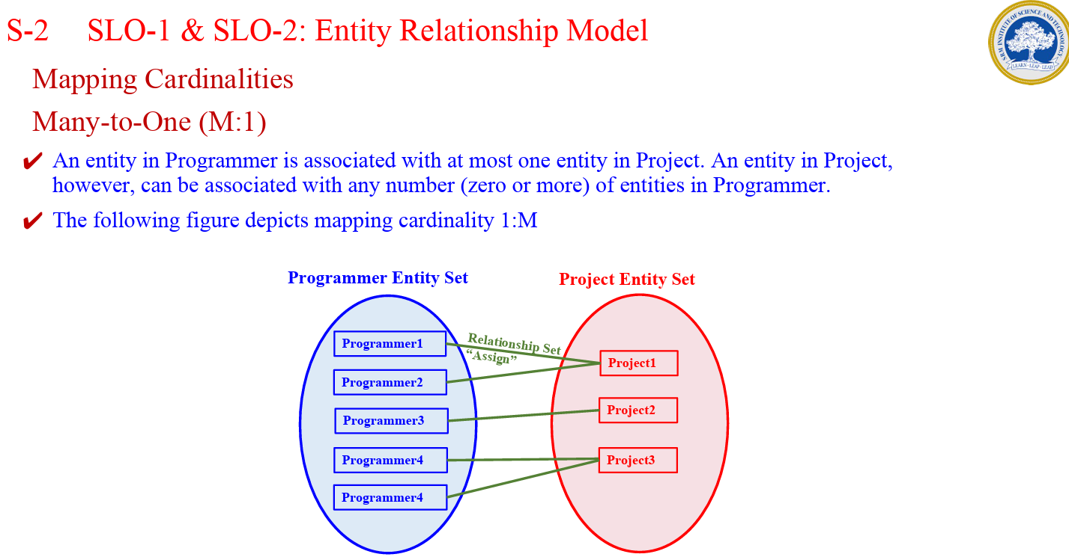

Slide 38
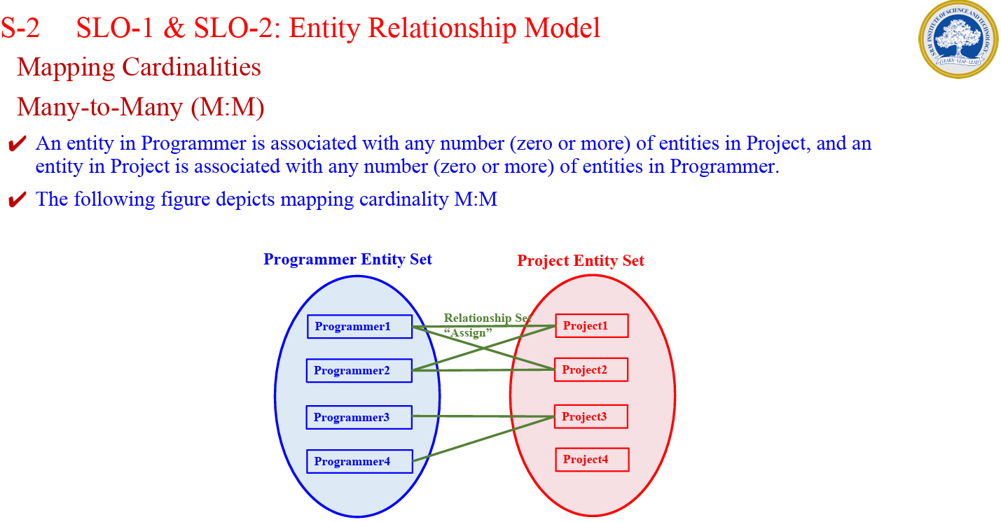

Slide 39
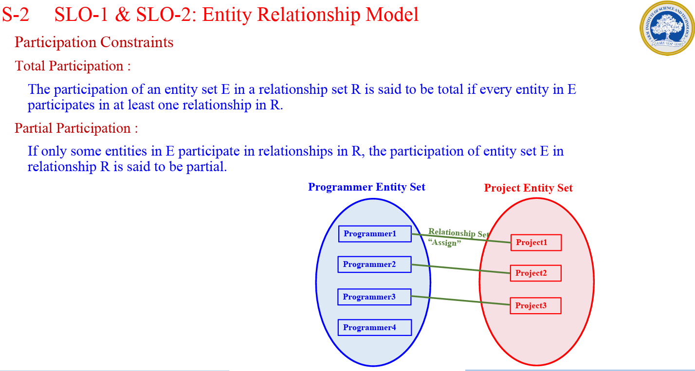

Slide 40
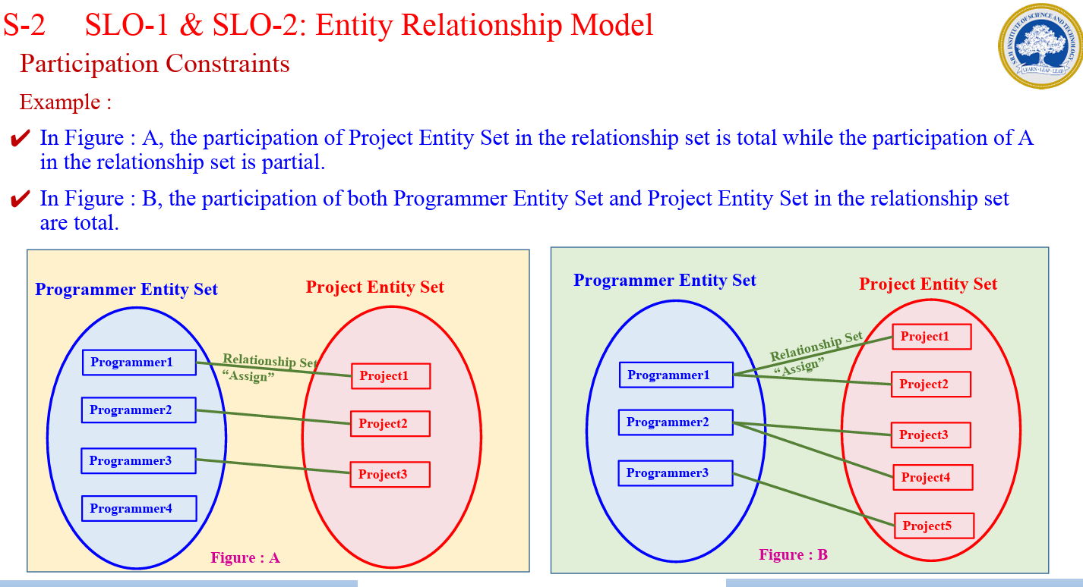

Slide 41
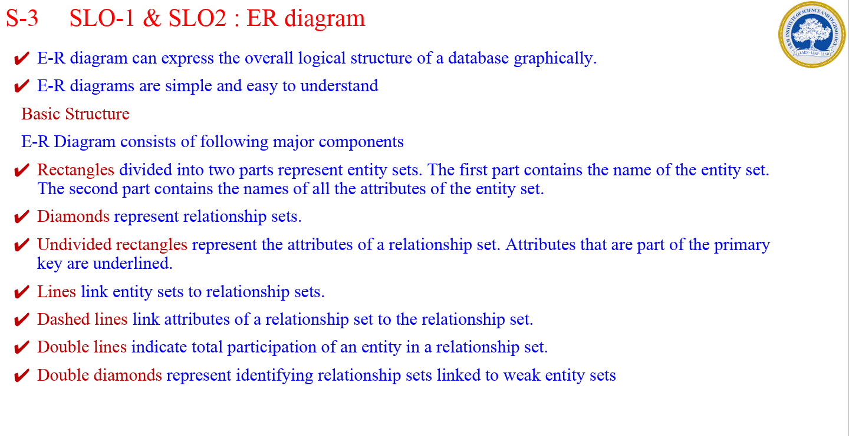

Slide 42
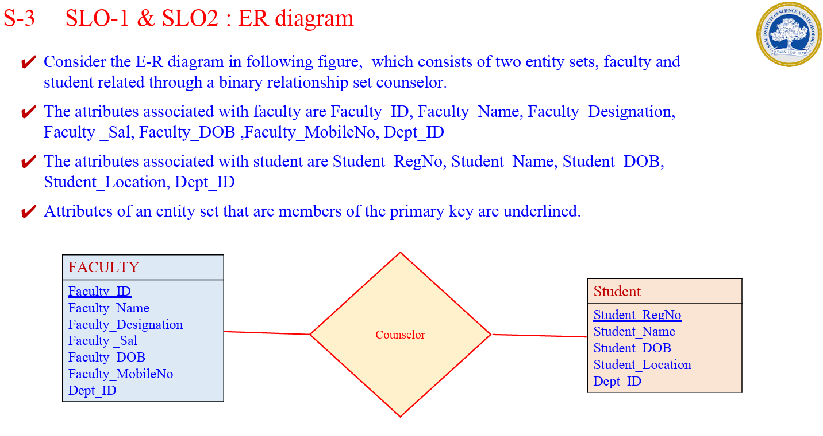

Slide 43
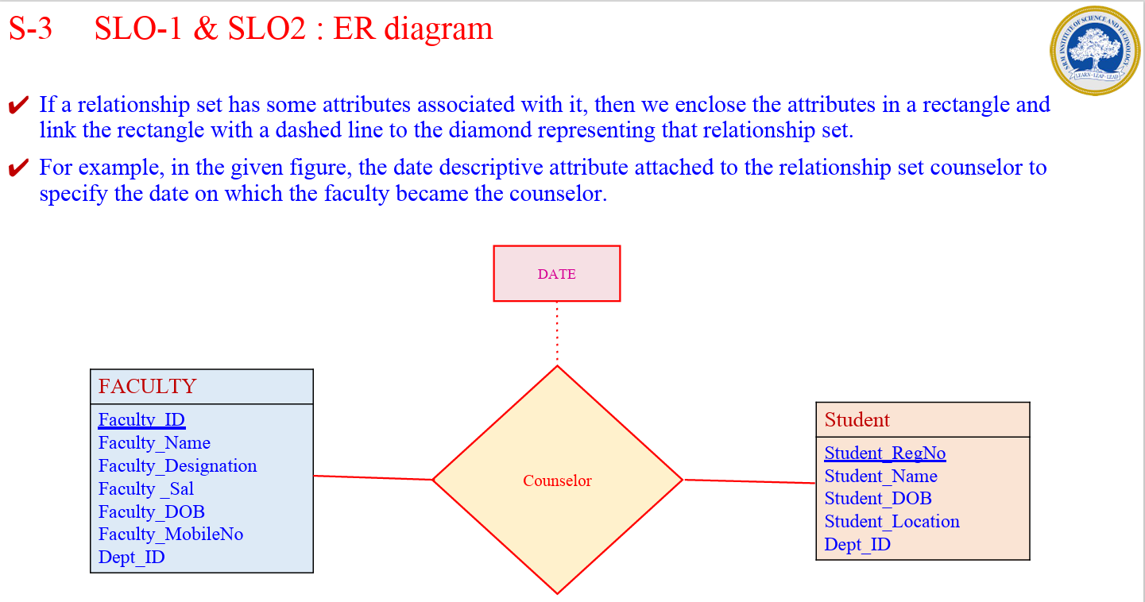

Slide 44
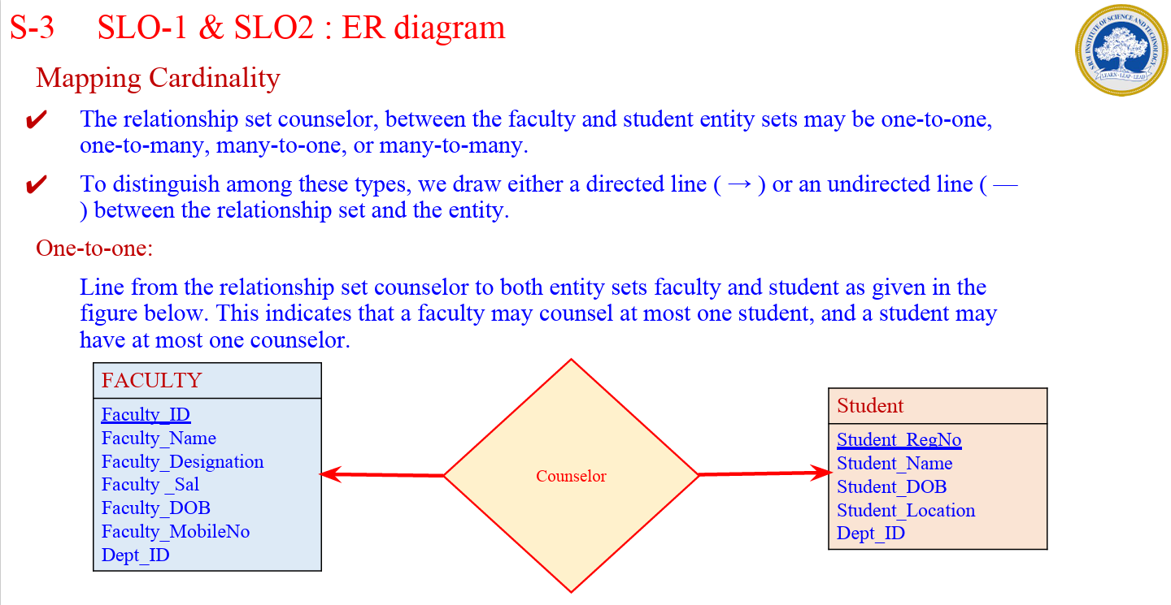

Slide 45
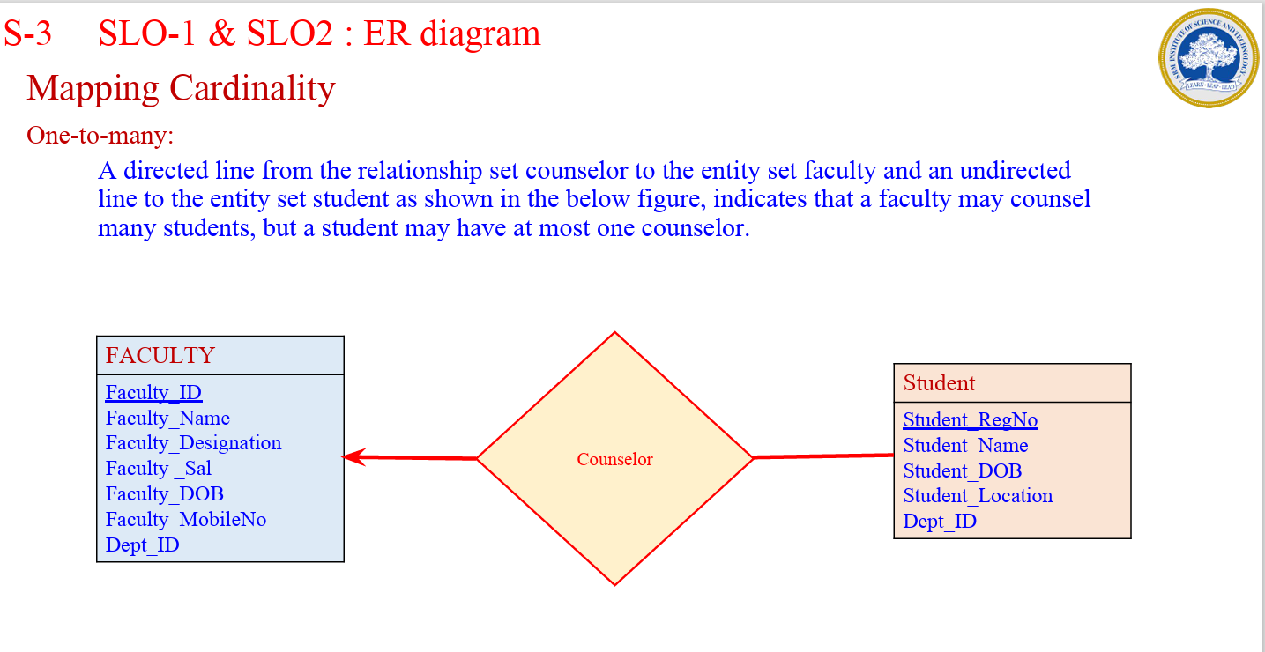

Slide 46
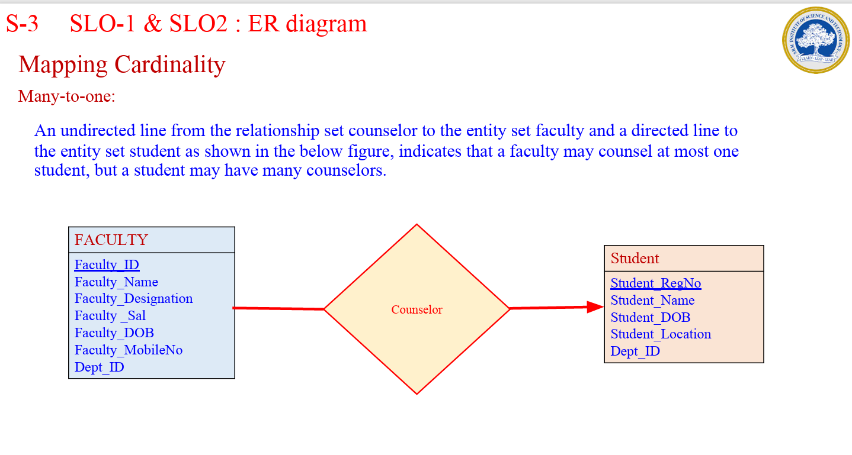

Slide 47
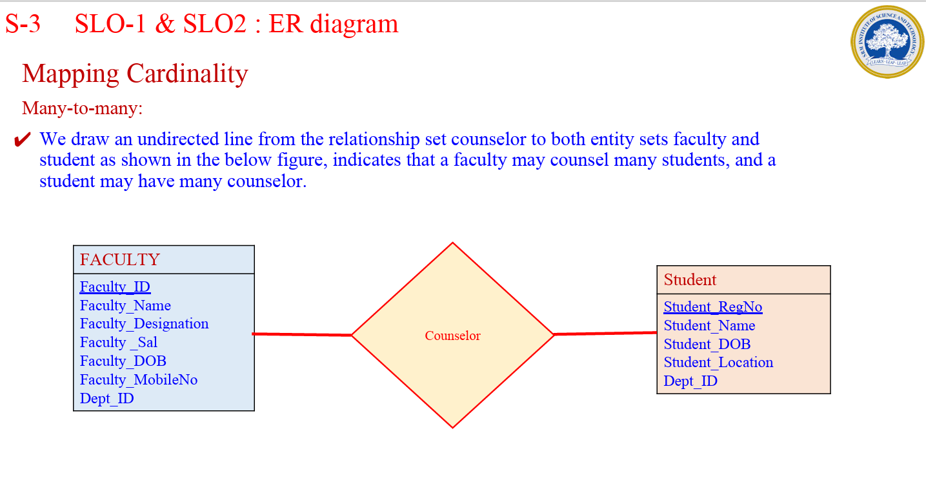

Slide 48
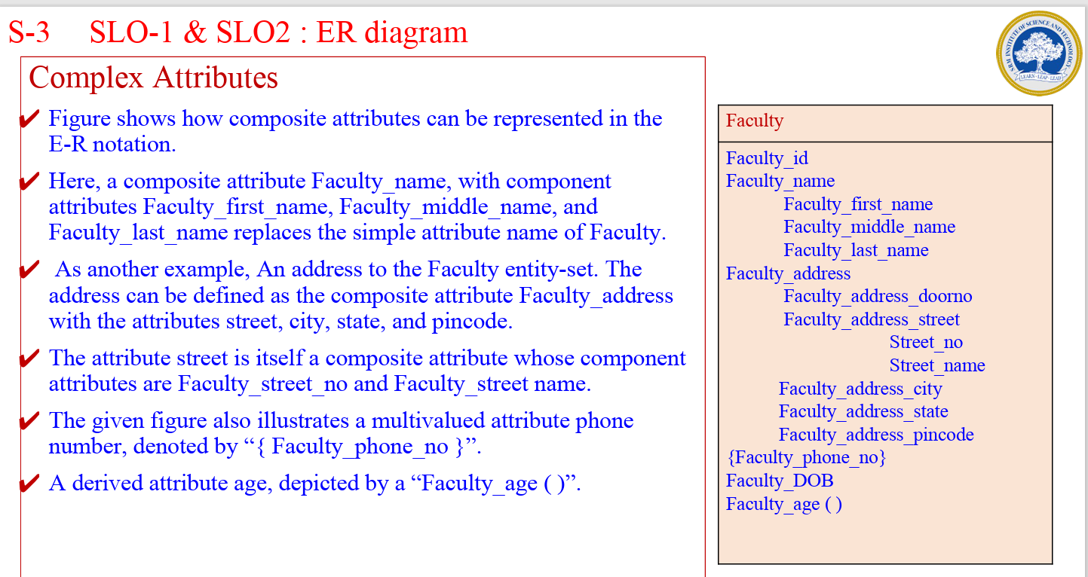

Slide 49
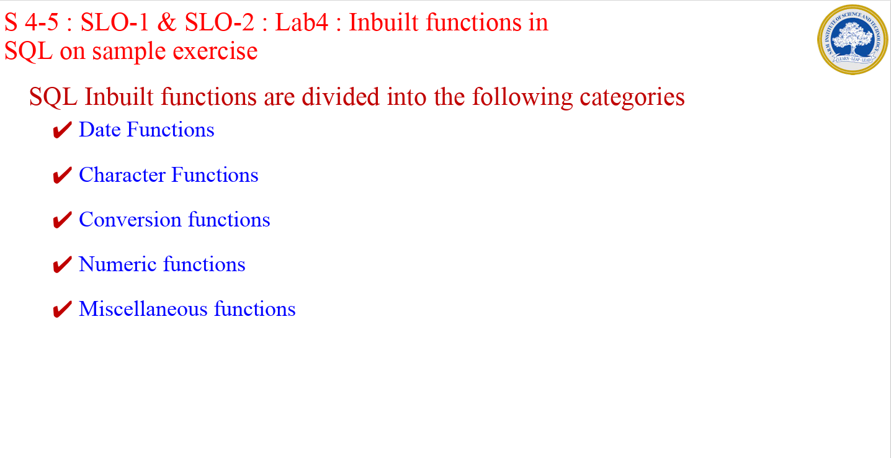

Slide 50
Selecting from the DUAL Table
DUAL is a table automatically created by Oracle Database along with the data dictionary. DUAL is in the schema of the user SYS but is accessible by the name DUAL to all users. It has one column, DUMMY, defined to be VARCHAR2(1), and contains one row with a value X. Selecting from the DUAL table is useful for computing a constant expression with the SELECT statement. Because DUAL has only one row, the constant is returned only once. Alternatively, you can select a constant, pseudocolumn, or expression from any table, but the value will be returned as many times as there are rows in the table. Refer to "About SQL Functions" for many examples of selecting a constant value from DUAL.

Slide 51
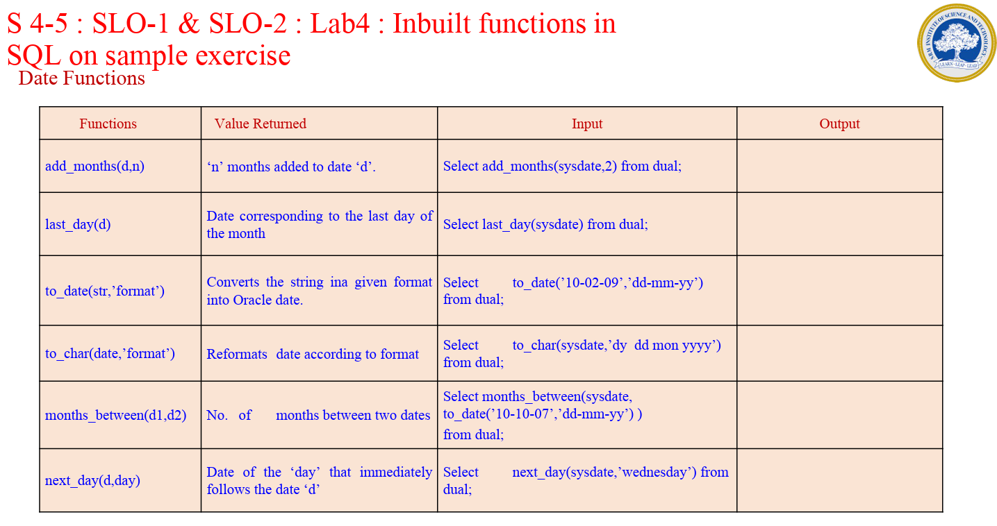

Slide 52
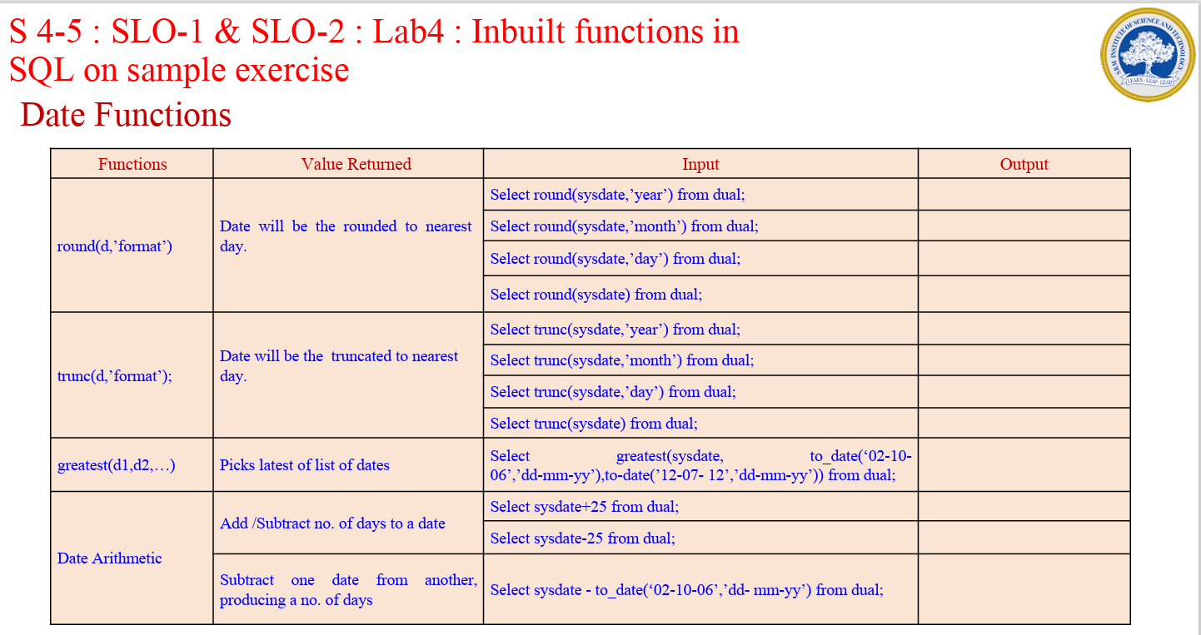

Slide 53
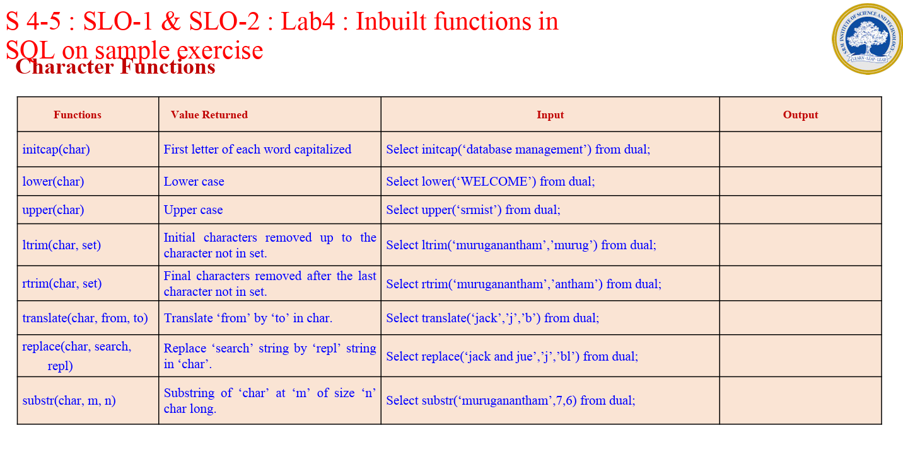

Slide 54
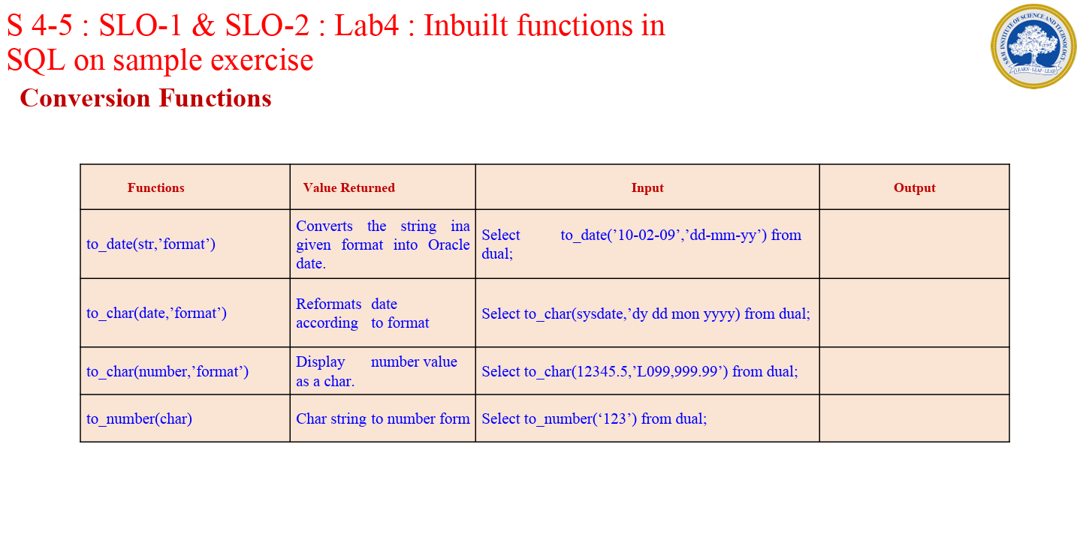

Slide 55
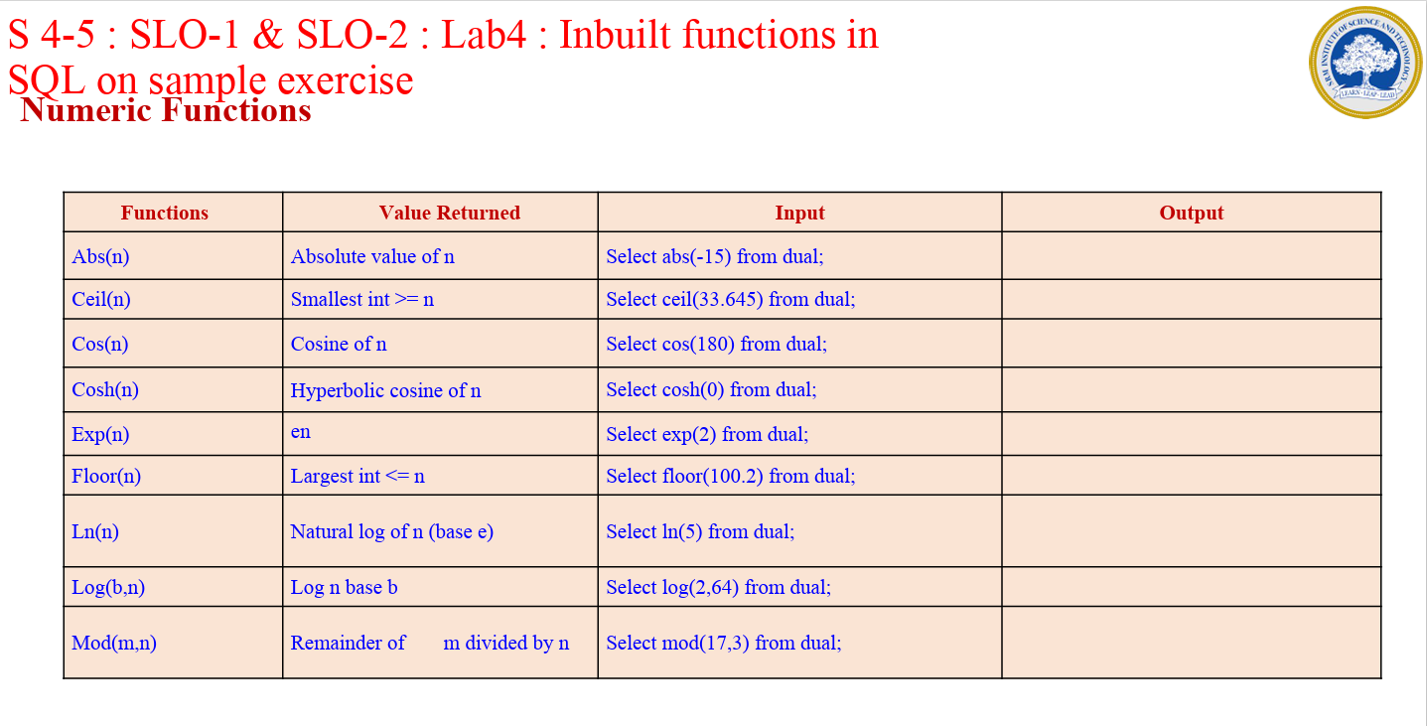

Slide 56
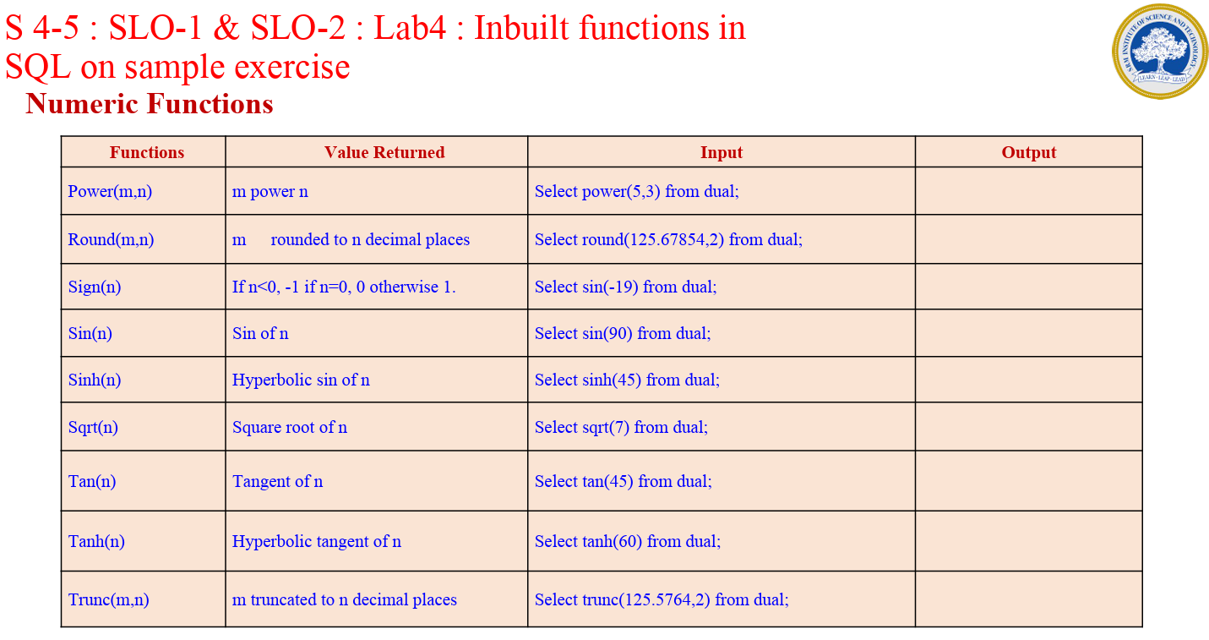

Slide 57
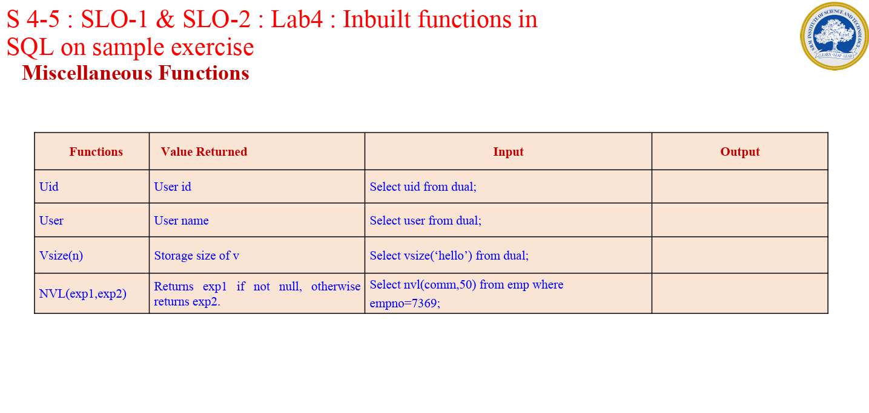

Slide 58
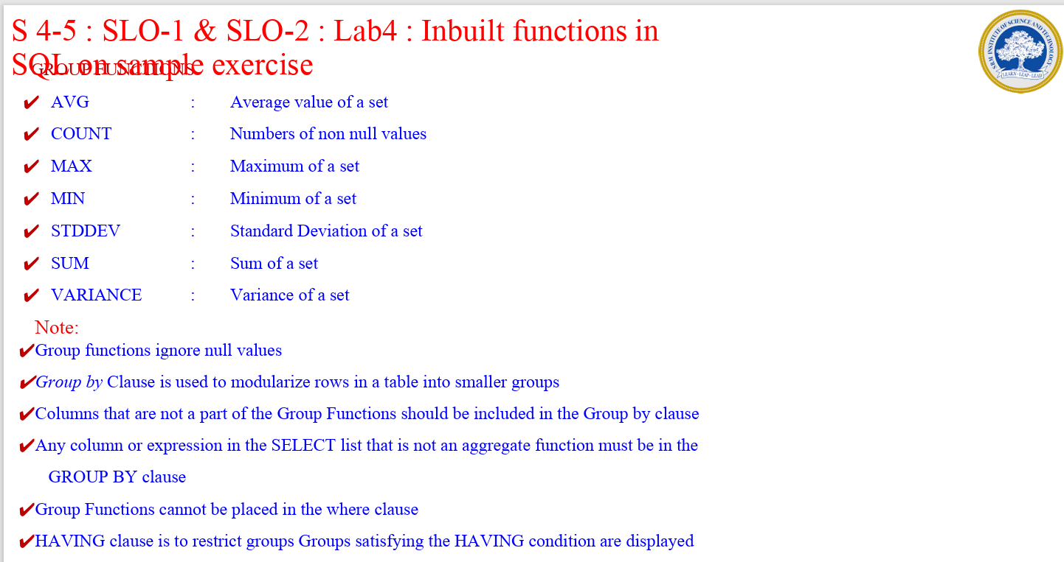

Slide 59
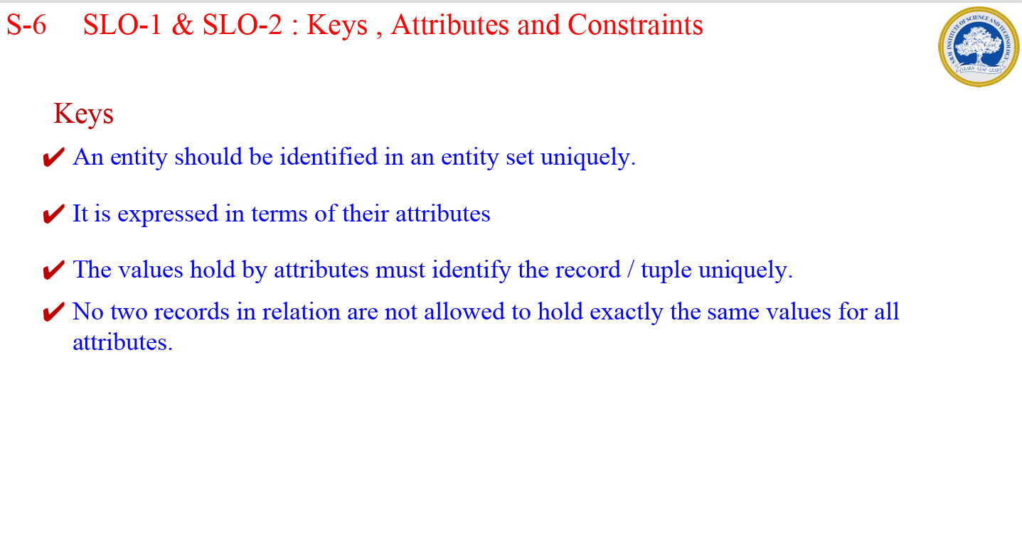

Slide 60
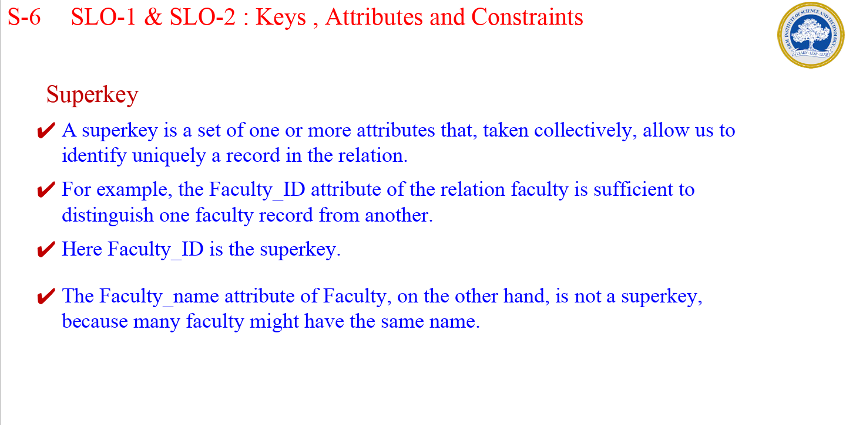

Slide 61
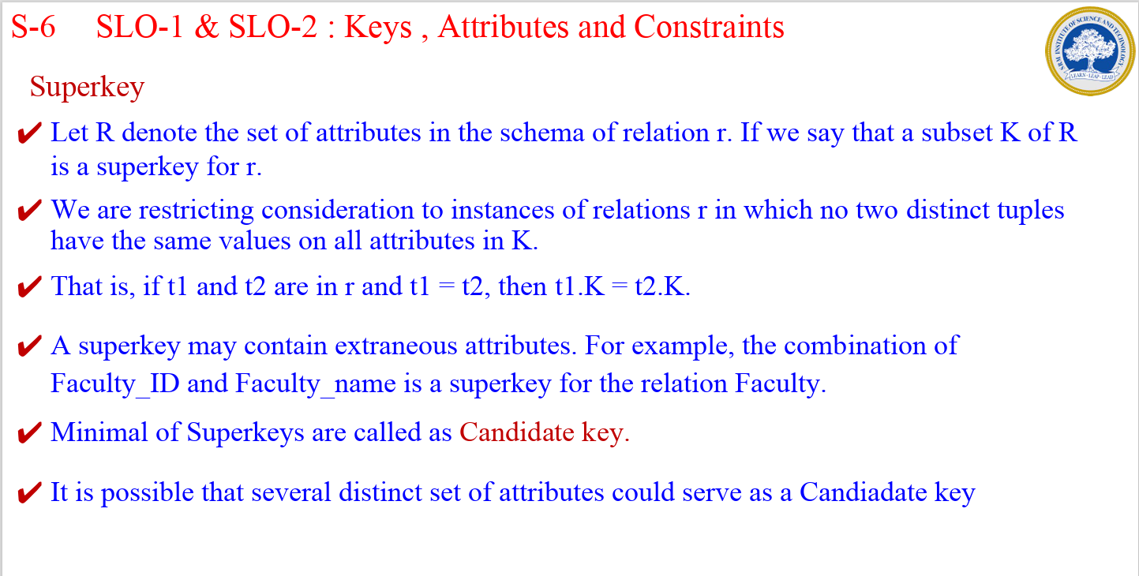

Slide 62
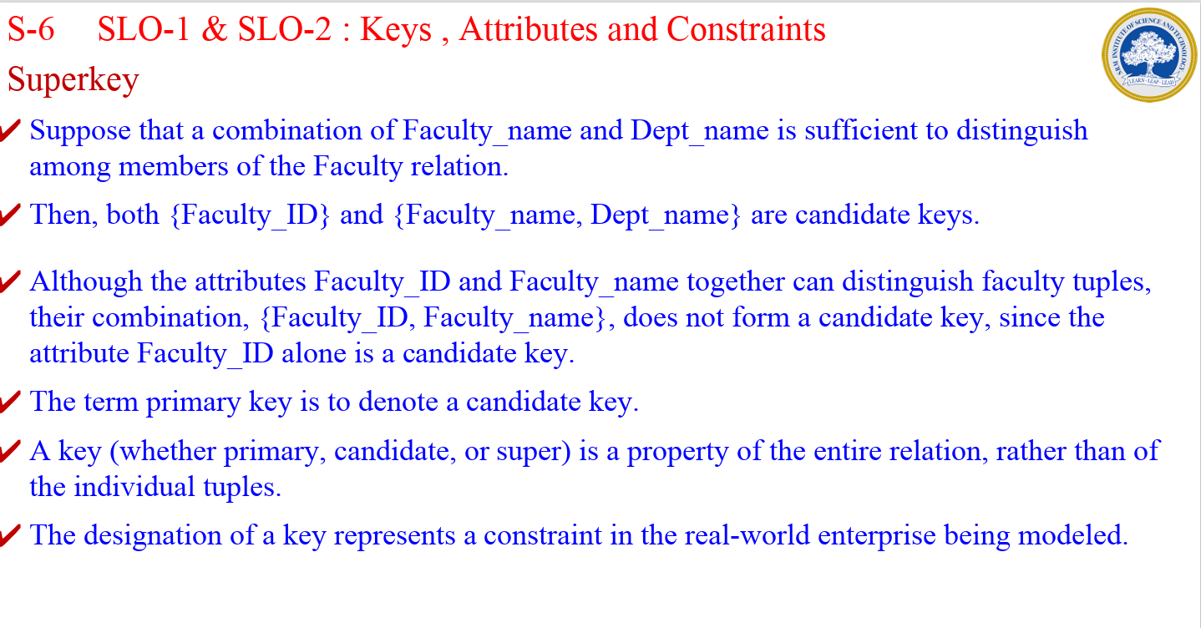

Slide 63


Slide 64


Slide 65


Slide 66


Slide 67


Slide 68


Slide 69


Slide 70


Slide 71


Slide 72


Slide 73


Slide 74
Domain constraints in DBMS are the set of rules which defines what kind of attributes can be stored in an entity (a table that stores data). Domain Constraints help us to enter the data into the table according to the particular data type.

Slide 75


Slide 76
Not null constraint
The entity (data table) may contain some fields which don't have any value. We can say it contains some missing values. These unassigned or missing values are called null values.
But, it is not possible to accept the null values all the time. So, Not Null Constraint is used which restricts a column not to accept the missing null values by default.
This means that you cannot insert a new column or record without assigning values in the fields of that column.

Slide 77


Slide 78


Slide 79


Slide 80
_______________is used which restricts a column not to accept the missing null values by default.
This constraint works as a filter that limits the data in some range.

Slide 81


Slide 82
Referential Integrity Constraint
Referential Integrity Constraint ensures that there must always exist a valid relationship between two relational database tables.
This valid relationship between the two tables confirms that a foreign key exists in a table.
It should always reference a corresponding value or attribute in the other table or be null.

Slide 83


Which is foreign key? Is there integrity Violation? Yes or No

Slide 84


Slide 85

Refer slide number 34 to 47 for a detailed note

Slide 86
strong entity set
weak entity set
A weak entity set is an entity set that does not contain sufficient attributes to uniquely identify its entities.
In other words, a primary key does not exist for a weak entity set.
However, it contains a partial key called as a discriminator.
Discriminator can identify a group of entities from the entity set.
Discriminator is represented by underlining with a dashed line
A strong entity set is an entity set that contains sufficient attributes to uniquely identify all its entities.
In other words, a primary key exists for a strong entity set.
Primary key of a strong entity set is represented by underlining it.

Slide 87

Adouble diamond symbol is used for representing the relationship that exists between the strong and weak entity sets and this relationship is known as identifying relationship.

Slide 88
Strong entity set | Weak entity set
A single rectangle is used for the representation of a strong entity set. | A double rectangle is used for the representation of a weak entity set.
It contains sufficient attributes to form its primary key. | It does not contain sufficient attributes to form its primary key.
A diamond symbol is used for the representation of the relationship that exists between the two strong entity sets. | A double diamond symbol is used for the representation of the identifying relationship that exists between the strong and weak entity set.
A single line is used for the representation of the connection between the strong entity set and the relationship. | A double line is used for the representation of the connection between the weak entity set and the relationship set.
Total participation may or may not exist in the relationship. | Total participation always exists in the identifying relationship.

Slide 90


Slide 91
Today the complexity of the data is increasing so it becomes more and more difficult to use the traditional ER model for database modeling. To reduce this complexity of modeling we have to make improvements or enhancements to the existing ER model to make it able to handle the complex application in a better way.
Enhanced entity-relationship diagrams are advanced database diagrams very similar to regular ER diagrams which represent the requirements and complexities of complex databases.
It is a diagrammatic technique for displaying the Sub Class and Super Class; Specialization and Generalization; Union or Category; Aggregation etc.

Slide 92


Slide 93


Slide 94


Slide 95


Slide 96


Slide 97


Slide 98


Slide 99


Slide 100


Slide 101


Slide 102


Slide 103


Slide 104


Slide 105


Slide 106


Slide 107


Slide 108


Slide 109


Slide 110


Slide 111

Aggregation
It is an abstraction in which relationship sets are treated as higher level entity sets and can participate in relationships. Aggregation allows us to indicate that a relationship set participates in another relationship set.
Aggregation is used to simplify the details of a given database where ternary relationships will be changed into binary relationships. Ternary relation is only one type of relationship which is working between three entities.

Slide 112


Slide 113


Slide 114


Slide 115


Slide 116


Slide 117


Slide 118


Slide 119


Slide 120


Slide 121


Slide 122



Slide 123


Slide 124


This table represents information about faculty members in a university system. Each row corresponds to a different faculty member, with columns indicating their unique identifier (faculty_id), name (faculty_name), department (dept_name), and salary.

Slide 125


This table stores information about various courses offered by a university. Each row represents a different course, with columns indicating the course code (course_code), title (title), department offering the course (dept_name), and number of credits (credits).

Slide 126


This table represents the prerequisite courses for each course. Each row indicates a prerequisite relationship between a course and its prerequisite, with columns indicating the course code (course_code) and the prerequisite code (prereq_code). For example, CS101 has a prerequisite of CS100, MATH202 has a prerequisite of MATH101, and PHY301 has a prerequisite of PHY202.

Slide 127


Slide 128


Slide 129




Slide 130
S-12 SLO-1 & SLO-2 : Relational Model
Database Schema
✔Consider the university database example
✔Each course in a university may be offered multiple times, across different semesters, or even within a semester.
✔A relation to describe each individual offering, or section, of the class.
✔The schema is: section (course_code, sec id, semester, year, location, room slot id)
✔To describe the association between faculty and the class sections that they teach. teaches (faculty_id, course id, sec id, semester, year)

Slide 131



Slide 132



Slide 133


Slide 134


Slide 135


Slide 136


Slide 137


Slide 138


Slide 139


Slide 140


Slide 141


Slide 142


Slide 143


Slide 144


Slide 145


Slide 146


Slide 147


Slide 148


Slide 149


Slide 150


Slide 151


Slide 152


Slide 153


Slide 154


